Slide 1

OECD
Economic
Outlook
Under pressure
Stefano Scarpetta
OECD Chief Economist
3 June 2026

Slide 2
A time-limited disruption would slow growth
Real GDP growth
2025
2026
2027
Year-on-year, %
3.4
2.8
3.1
World
1.8
1.5
1.7
OECD
4.7
3.8
4.2
Non-OECD
Time-limited disruption scenario
Note: World and OECD aggregates use moving nominal GDP weights at purchasing power parities.
Source: OECD Economic Outlook 119 databases; and OECD calculations.

Slide 3
GDP growth projections – G20 economies
Real GDP growth, year-on-year, %
Time-limited disruption scenario
Note: Revisions relative to the estimates from the December 2025 Economic Outlook. India projections are based on fiscal years, starting in April. World and G20 aggregates use moving nominal GDP weights at purchasing power parities.
Source: OECD Economic Outlook 119 databases; OECD Economic Outlook 118 database; and OECD calculations.

Slide 4
GDP growth projections – Non-G20 OECD economies
Time-limited disruption scenario
Real GDP growth, year-on-year, %
Note: Revisions relative to the estimates from the December 2025 Economic Outlook.
Source: OECD Economic Outlook 119 database; OECD Economic Outlook 118 database; and OECD calculations.

Slide 5
A prolonged disruption would cause longer-lasting damage to growth
Real GDP growth
2025
2026
2027
Year-on-year, %
3.4
2.8
2.1
3.1
1.8
World
1.8
1.5
0.9
1.7
0.5
OECD
4.7
3.8
3.0
4.2
2.8
Non-OECD
Time-limited disruption scenario
Prolonged disruption scenario
Note: World and OECD aggregates use moving nominal GDP weights at purchasing power parities.
Source: OECD Economic Outlook 119 databases; and OECD calculations.

Slide 6
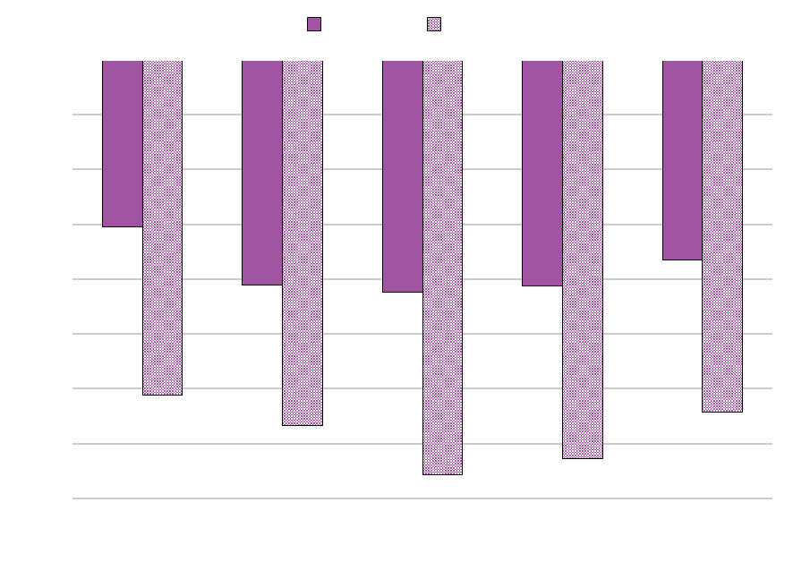
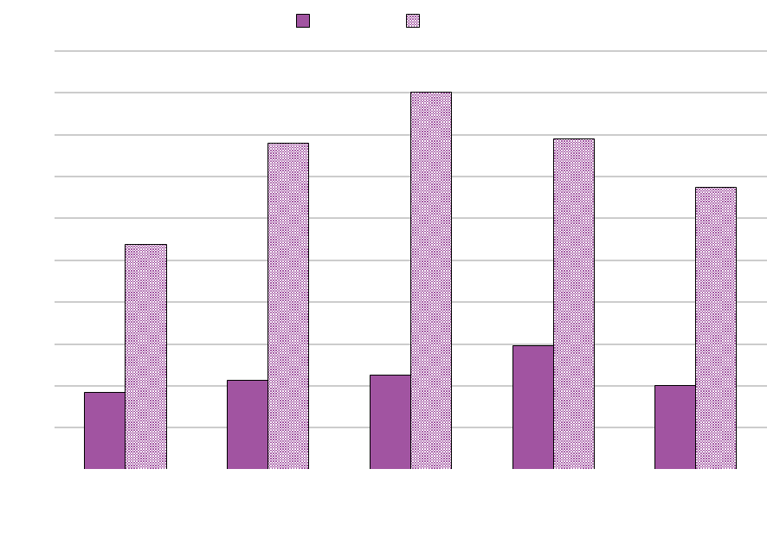
Economic growth in Asia is particularly exposed to a prolonged disruption
Real GDP growth
Consumer price inflation
% point difference relative to time-limited disruption scenario
% point difference relative to time-limited disruption scenario
Note: Simulations are based on the forward-looking NiGEM global macroeconomic model. The prolonged disruption scenario assumes oil, gas and fertiliser prices rise by 50% relative to the time-limited disruption scenario till Q3 2027, followed by a gradual decline as supplies recover. The scenario also assumes lower technical efficiency due to energy rationing and supply-chain disruptions, higher household saving and tighter financial conditions, including a 15% decline in equity prices, higher investment risk premia (75-100 basis points) and a 50 basis point increase in long-term government bond term premia.
Source: OECD calculations using the NiGEM macroeconomic model.

Slide 7
OECD
Economic
Outlook
Risks

Slide 8
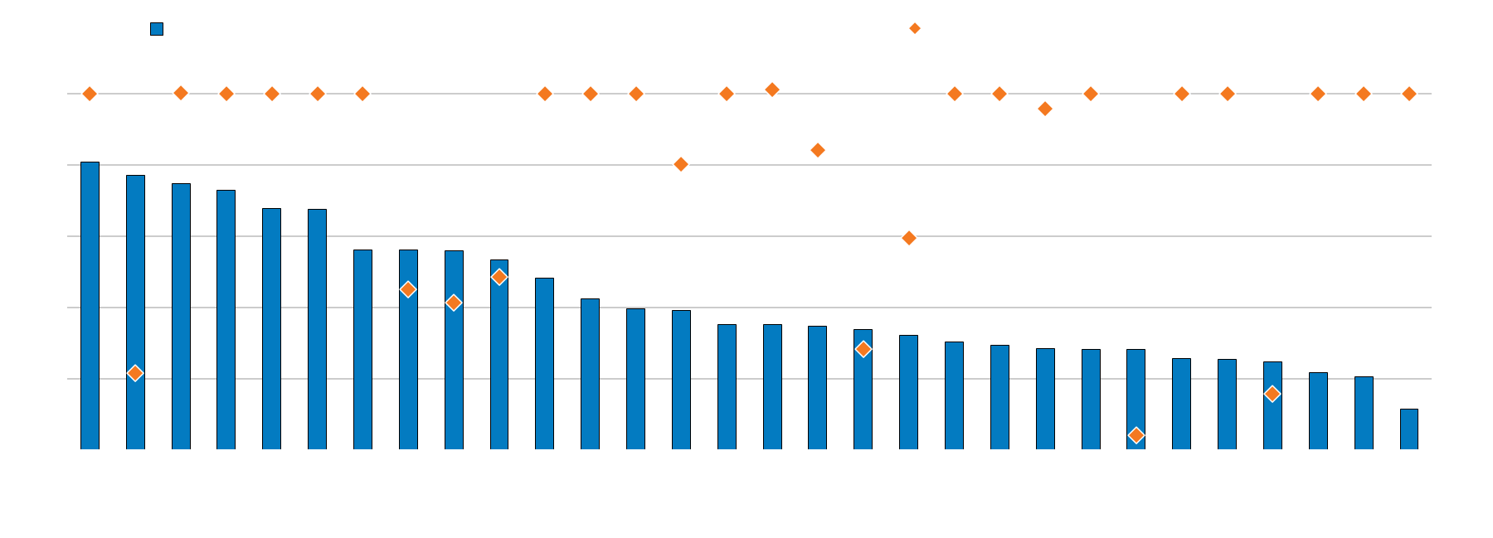
Higher food prices would particularly hurt the poorest
Agricultural reliance on nitrogen fertiliser imports from the Persian Gulf
Note: The figure shows the quantity of imported nitrogen-based fertilisers as a share of the total quantity of nitrogen-based fertilisers applied for use agriculturally. Net imports equal to one mean the country relies on imports to meet its fertiliser needs. A figure of less than one suggests domestic production is used to meet fertiliser needs, with numbers close to zero suggesting imports are not very important; a number less than zero (not shown) exists for countries which are net exporters, (e.g. China, Russia and Saudi Arabia). These re-exports account for the difference between net and total imports and are not shown. Persian Gulf countries are Bahrain, Iran, Iraq, Kuwait, Oman, Qatar, Saudi Arabia and United Arab Emirates. Shares of imports from the Persian Gulf are based on the FAO trade matrix database; agricultural use and gross and net imports are based on the FAO nutrient database.
Source: Food and Agriculture Organisation (FAO) Agricultural database; and OECD calculations.

Slide 9
US import tariffs have decreased, but trade tensions still pose a risk to growth
Estimated changes in US effective tariffs
%
Note: Estimated change in tariff rates based on applicable rates to products and countries at the time they became effective, weighted by country-specific product shares of United States imports in 2024. Changes relative to December 2024 tariff levels. The mid-November 2025 estimates were published in the December 2025 OECD Economic Outlook, prior to the ratification of the framework agreement between the United States and Switzerland.
Source: US Census Bureau; the White House; US Federal Register; and OECD calculations.

Slide 10
US import tariffs have decreased, but trade tensions still pose a risk to growth
Estimated changes in US effective tariffs
%
Note: Estimated change in tariff rates based on applicable rates to products and countries at the time they became effective, weighted by country-specific product shares of United States imports in 2024. Changes relative to December 2024 tariff levels. The mid-November 2025 estimates were published in the December 2025 OECD Economic Outlook, prior to the ratification of the framework agreement between the United States and Switzerland.
Source: US Census Bureau; the White House; US Federal Register; and OECD calculations.

Slide 11
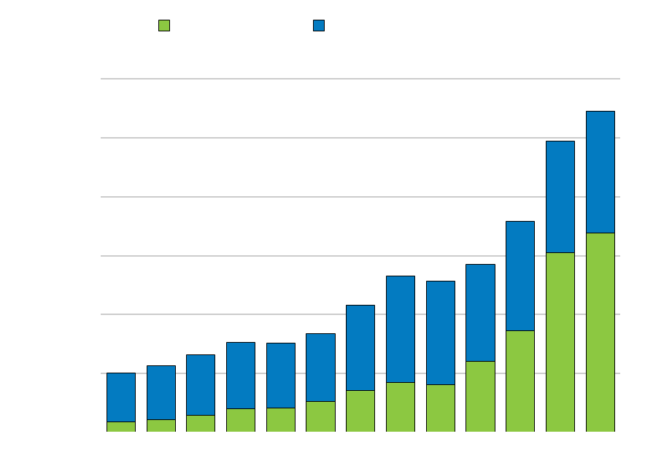
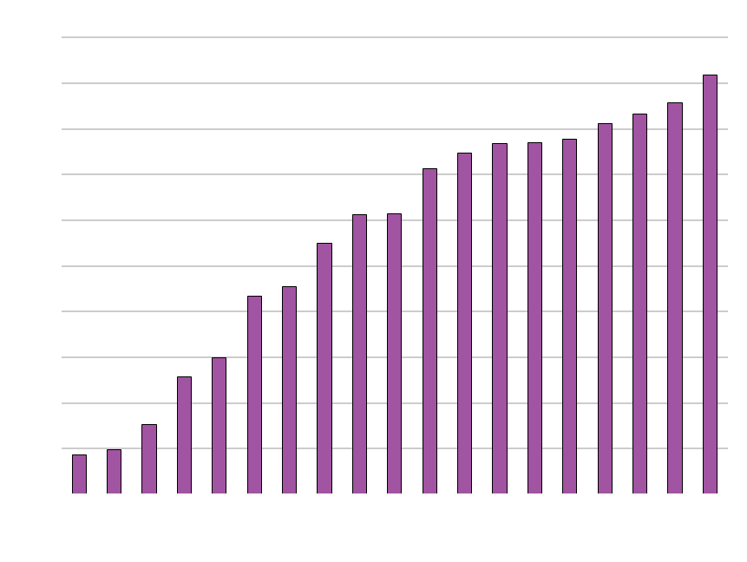
Rapid advances in AI technologies bring hopes and risks
AI Companies’ capital expenditure
Projected per capita real income gains due to AI over the next 10 years
USD billion
Percentage points, annualised
Note: In the left graph, the “Magnificent 7” comprises Alphabet, Amazon, Apple, Meta, Microsoft, Nvidia and Tesla. Other AI companies are identified based on the constituents of the iShares and X-trackers exchange traded funds invested in AI firms as of December 2025. Projections for 2026 and 2027 as of 31 March 2026. Earnings are measured by EBITDA (earnings before interest, tax and amortization). The right-hand side graph shows predicted per capita real income gains due to AI over the next 10 years, in percentage points and annualised terms. Medium adoption and expanded AI capabilities assume adoption follows the same trajectory as ICT technologies, increasing 40% over 10 years, and that AI reaches higher capabilities thanks to synergies with additional software.
Source: Bloomberg; LSEG; White & Case; Filippucci et al: “AI meets trade: Global linkages and the cross-country distribution of the gains from AI” (forthcoming), and OECD calculations.

Slide 12
OECD
Economic
Outlook
Policies

Slide 13
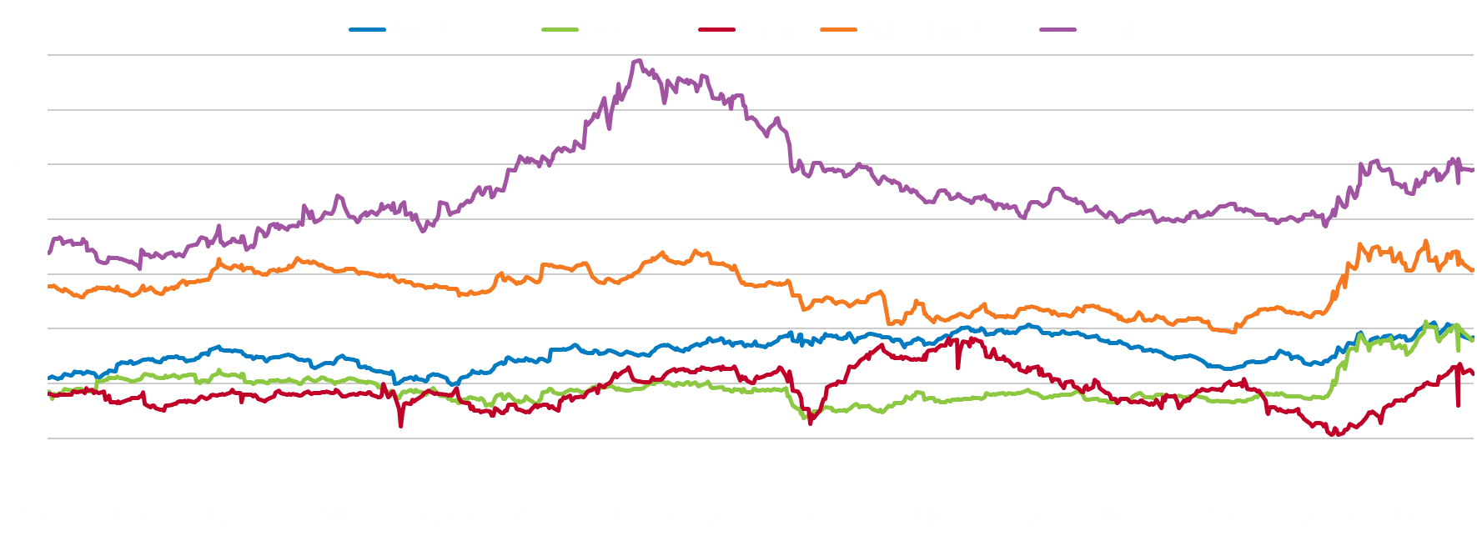
Central banks need to balance the risk of persistent inflation against the risk of a sharp slowdown
Two-year inflation expectations
%
Note: Financial market-based inflation expectations are derived from two-year inflation swap zero coupon rates, except for Brazil, where the two-year breakeven inflation rate is used.
Source: Bloomberg; and OECD calculations.

Slide 14
Governments introduced relief mainly via direct price controls or tax measures
Type of measures in the OECD Energy Support Measures Tracker
Count of measures
Note: The chart classifies support measures along two dimensions. First, measures are grouped by type of support: energy price relief, income support, credit and equity support, or other measures. Second, measures are classified by implementation mechanism, such as tax measures, regulated or capped prices, budgetary transfers, regulatory actions, or financial support instruments. Data covers 31 OECD countries and 15 non-OECD economies: Argentina, Brazil, Bulgaria, China, Croatia, India, Indonesia, Malaysia, Morocco, the Philippines, Romania, South Africa, Thailand, Ukraine, and Viet Nam. Data as of 18 May 2026.
Source: 2026 OECD Energy Support Tracker

Slide 15
As the crisis persists, measures need to be more targeted and preserve incentives to save energy
Type of measures in the OECD Energy Support Measures Tracker
Count of measures
Note: The chart classifies support measures along two dimensions. First, measures are grouped by type of support: energy price relief, income support, credit and equity support, or other measures. Second, measures are classified by implementation mechanism, such as tax measures, regulated or capped prices, budgetary transfers, regulatory actions, or financial support instruments. Data covers 31 OECD countries and 15 non-OECD economies: Argentina, Brazil, Bulgaria, China, Croatia, India, Indonesia, Malaysia, Morocco, the Philippines, Romania, South Africa, Thailand, Ukraine, and Viet Nam. Data as of 18 May 2026.
Source: 2026 OECD Energy Support Tracker

Slide 16
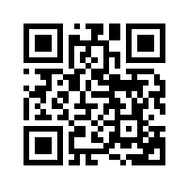
Thank you!
Find out more about our work:

